Slide 1
HOUSE SALES IN KING COUNTY
BENSON MUNGAI MURIU

Slide 2
AGENDAS
Overview of house sales in King County.
Factors affecting house sales in King County
Analysis of how renovations affect sales of houses.

Slide 3
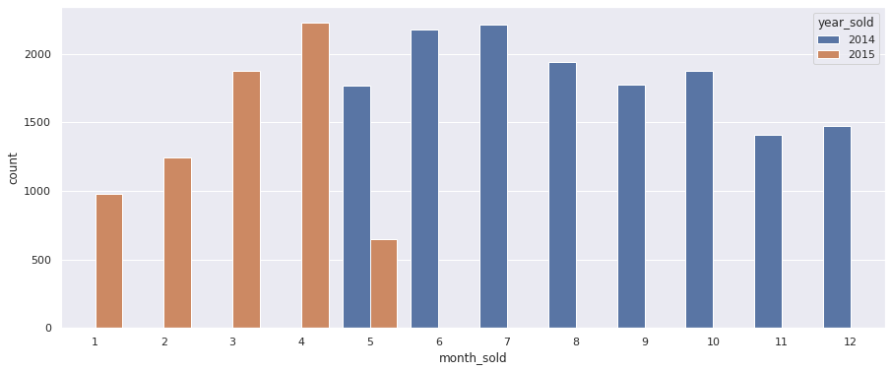
OVERVIEW OF HOUSE SALES IN KING COUNTY

Slide 4
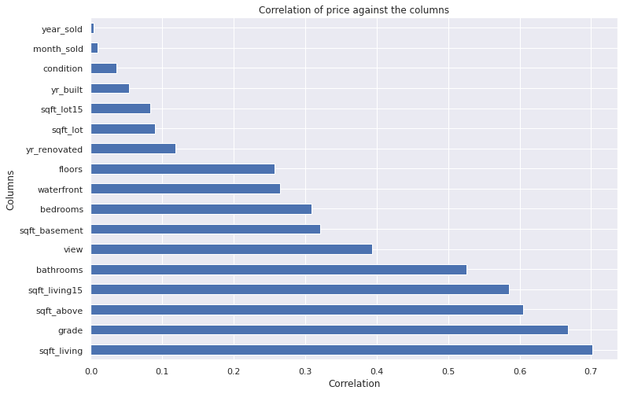
FACTORS AFFECTING HOUSE SALES IN KING COUNTY

Slide 5
ANALYSIS OF RENOVATIONS TO HOMES
The average home in King County is sold at $540,000
Out of the houses sold only 744 houses were renovated
The houses renovated showed an increment of house value
The average increment per house was about 274$, but with more data to analyses the number will go higher.

Slide 6
CONCLUSIONS
The variables affect the price differently where categorical variables show a how different categories perform price wise and continuous variables show how an increase in a variable affects the price of the house.
The square footage of the house of the home is what affect the price the most compared variables, followed by grade.
Most houses are at average condition and average grade therefore this is a good standard
Above half of the houses have never been renovated before.
In the models, it is noted that house increase prices with variables that have above average rating in most variables.
From observation, considering less houses have not been renovated, it shows an increase in the value of the house by an average of 274$
In conclusion, houses increase value when renovation takes place to reach an average condition and grade of a normal house by 274$. More renovations made will increase the house prices by a larger value.

